Slide 1


ECONOMIC
DEVELOPMENT
FOR COUNTIES
ECO DEVO 101

Slide 2

INTRODUCTIONS
HELLO AND
SARA BLOOM
Community Development Specialist
Tim Zimmerman
Business Development Specialist

Slide 3
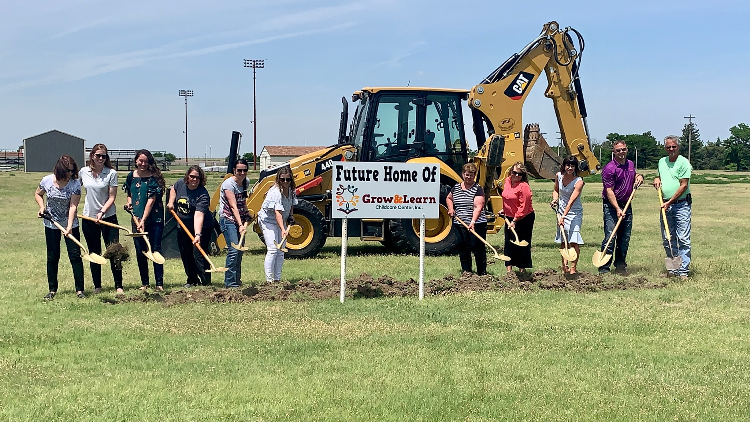

WHAT IS
ECONOMIC DEVELOPMENT?

Slide 4
DEFINITION
Economic Development is a program, group of policies, or activity that seeks to improve the economic well-being and quality of place for a community, by creating and/or retaining jobs that facilitate growth and provide a stable tax base.
Source: International Economic Development Council

Slide 5
WHAT IS ECONOMIC DEVELOPMENT?
It's the proactive management of the business atmosphere to encourage growth, promote prosperity and meet the needs of the community.
A community needs to EVALUATE, PLAN, and IMPLEMENT to be successful.

Slide 6
THE IMPORTANCE OF ECONOMIC DEVELOPMENT?
Assists in maintaining a desired lifestyle
Pays for basic government services
Ensures a future
Changes attitudes
Builds capacity for growth and sustainability

Slide 7













INVESTMENT MAKES A DIFFERENCE
parks
infrastructure
resources
taxes
public safety
overcoming
barriers
employees
housing funds
ECONOMIC
DEVELOPERS
SUCCESSFUL
BUSINESSES
COMMUNITY
social
fabric
strategic
mindset
quality of place
public employees

Slide 8
HOW DO YOU GET STARTED?
EVALUATE
PLAN
IMPLEMENT

Slide 9
EVALUATE
An honest evaluation of the community will determine success. The conversation can be difficult but is essential to developing a meaningful economic development program. Positive results begin with realistic expectations.
Current business climate
Regulatory environment
Needs vs. wants
Political willingness to use tools

Slide 10
PLAN
After evaluating the current conditions, an action plan can be developed for economic development. Broadly speaking, economic development activities fall into four different categories:
Retention and expansion: Businesses already in the community.
Business recruitment: Actively pursuing new businesses from outside the community.
Entrepreneurship: Long-term process of developing and supporting new small businesses.
Community vibrancy: Creating a quality place to live, work and play.

Slide 11
IMPLEMENT
Define roles
Understand roles
Resist the urge to become involved

Slide 12
THINGS TO CONSIDER
Do the math.
  What should your community use to determine success?
Everything has a cost and risk, real or perceived.
  Is the community willing to accept the risk and potential downsides of a development project?
Not all projects are the right project.
  It is important to consider what would happen if the project actually chooses your community.
Confidentiality is a must.
  Although it may be difficult to understand, confidentiality is required for success.

Slide 13
Be ready.
  Having all the necessary elements in place to accommodate a project saves the community and business a lot of headaches.
Think regionally.
  While every official answers to a constituency, business does not observe political boundaries. Building a strong business ecosystem enhances an individual community’s chances for success.
Think creatively.
  Most projects require some degree of creativity or flexibility at some point in the process.
Celebrate success.
  Too often communities fail to acknowledge their success or tell their story.
  Success may be small, but it must be celebrated.

Slide 14
WHO’S AT THE TABLE
Local Governments
State Governments
Federal Governments
Special Authorities – airports, stadiums, redevelopment
Public Private Partnerships
Chambers and Other Business Associations
Area Youth
Universities and Research Institutions
Community Colleges
Workforce Development
Neighborhood Groups
Utilities
Philanthropic Organizations
Notes:
Who need to leave the table?
C.A.V.E. Dwellers
Is it you?

Slide 15
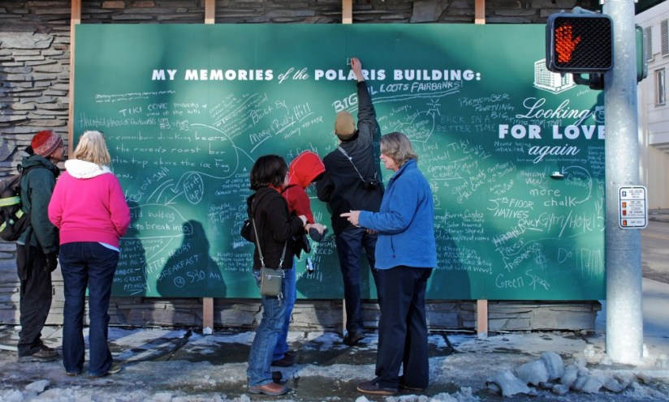
QUALITY OF
PLACE

Slide 16
IT ALL COMES DOWN TO QUALITY OF PLACE
“Quality of place” is our common denominator… it’s what keeps us around.
It attracts (and retains) the population, adds revenue, and boosts recognition and reputation.
It creates “maximum livability”

Slide 17
Jobs
Safety
Education
Environmental quality
Cultural and recreational amenities
Healthcare
Cost of living
Housing

Slide 18
WHAT CAN YOU DO AT A COUNTY LEVEL?
Create strong partnerships.
Encourage cooperation between County and City.
Be proactive, forward-thinking, and open.
Seek out partnerships and utilize friends.
“You can not shake hands with a clenched fist.”
-Indira Gandhi

Slide 19
WHAT CAN YOU DO AT A COUNTY LEVEL?
Take an active role in business recruitment, retention, and expansion.
Market the ROZ program.
Incentives and tax abatements.
Workforce training.
Planning and zoning for housing.
Childcare initiatives.
New energy solutions.

Slide 20
WHAT CAN YOU DO AT A COUNTY LEVEL?
Raise your standards.
No person or institution ever improved from lowering standards.
When we ask more of people they tend to rise to the occasion.
“Refuse to lower your standards to accommodate those who refuse to raise theirs.”
-Mandy Hale

Slide 21
WHAT CAN YOU DO AT A COUNTY LEVEL?
Improve appearances.
The way things appear forms our opinion of them.
It’s hard to be proud of something that is poorly maintained.
Appearances of a town not only affect visitors but the people living there.
When appearances improve, self-esteem improves.
“No area will prosper unless it attracts those who can choose to live wherever they wish.”
-Jonathon Barnett

Slide 22
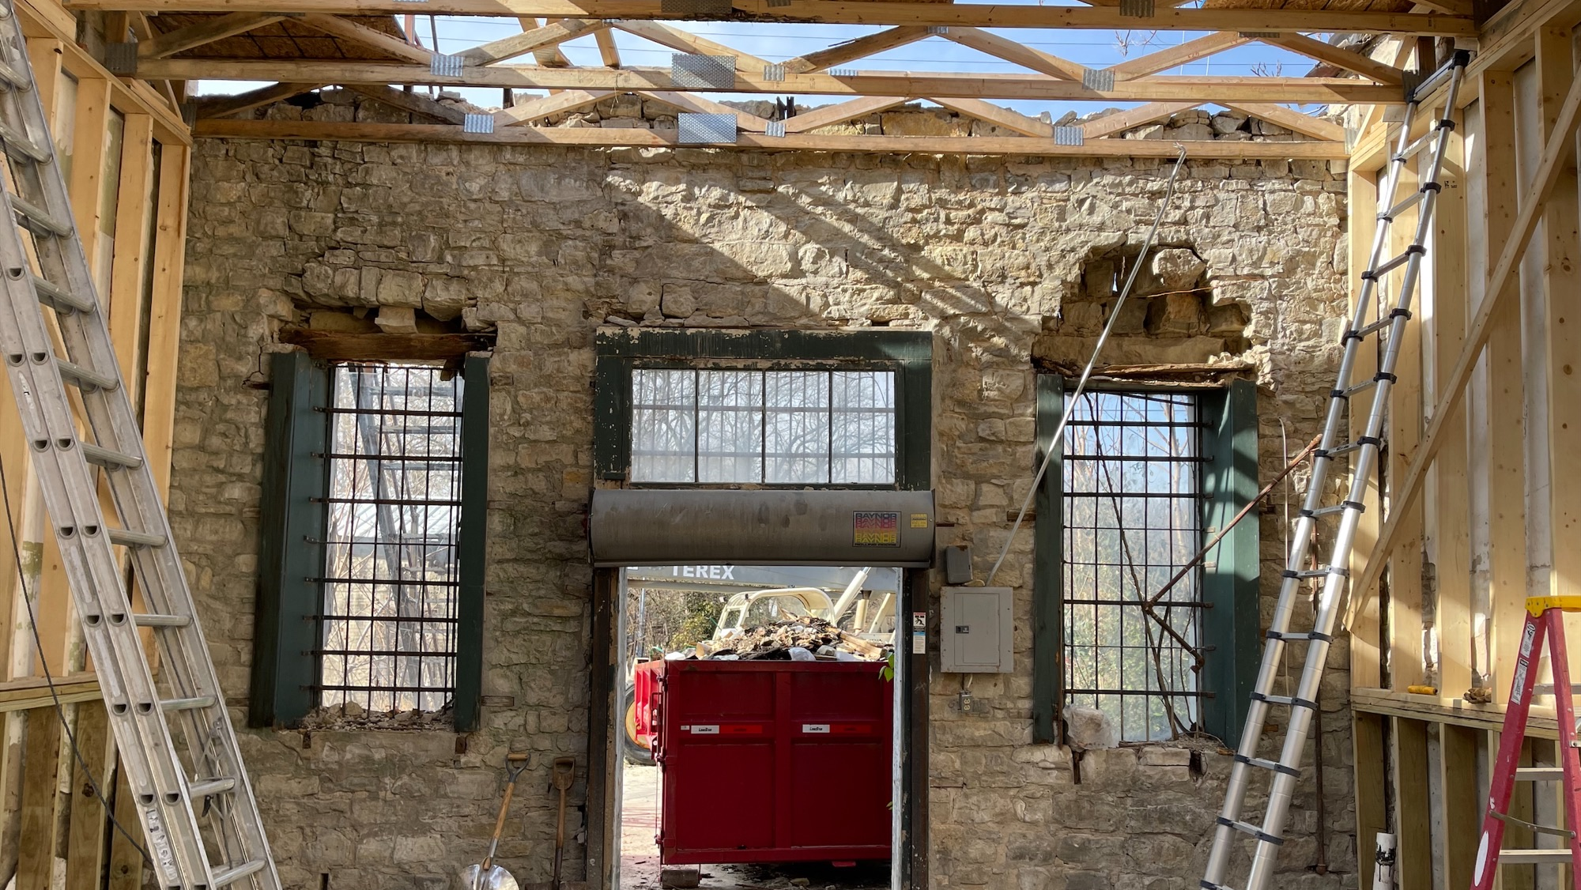
BONDS AND
WHERE TO START
Notes:
How do Counties get started?
A variety of uses for bonds.
Resource partners are available.

Slide 23
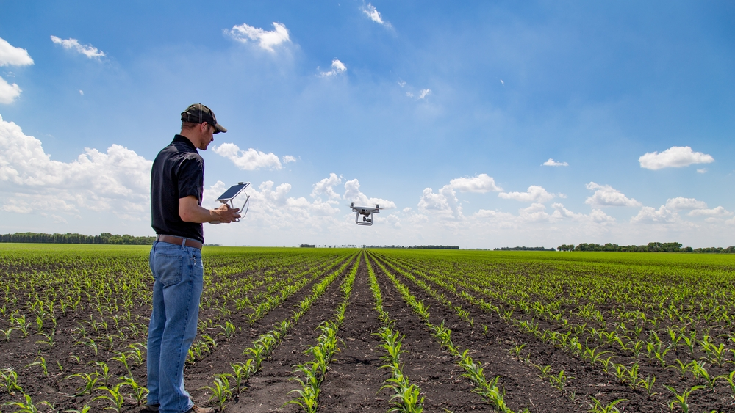
AGRICULTURE VS.
MANUFACTURING

Slide 24
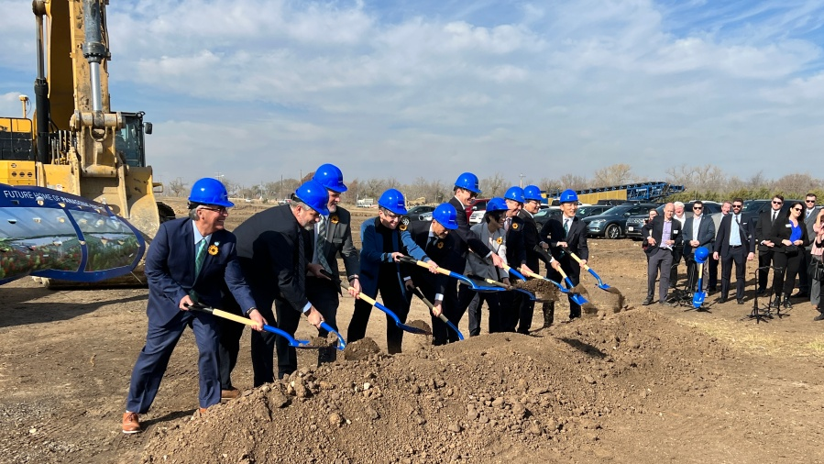
HOW CAN I GET A
PANASONIC?
Notes:
Most importantly, think regionally.
It’s more about leveraging regional assets (workforce, infrastructure, development friendly policies) and readiness
Positive outlooks, positive conversations.
Recognize the growth and potential of the state…

Slide 25


Slide 26
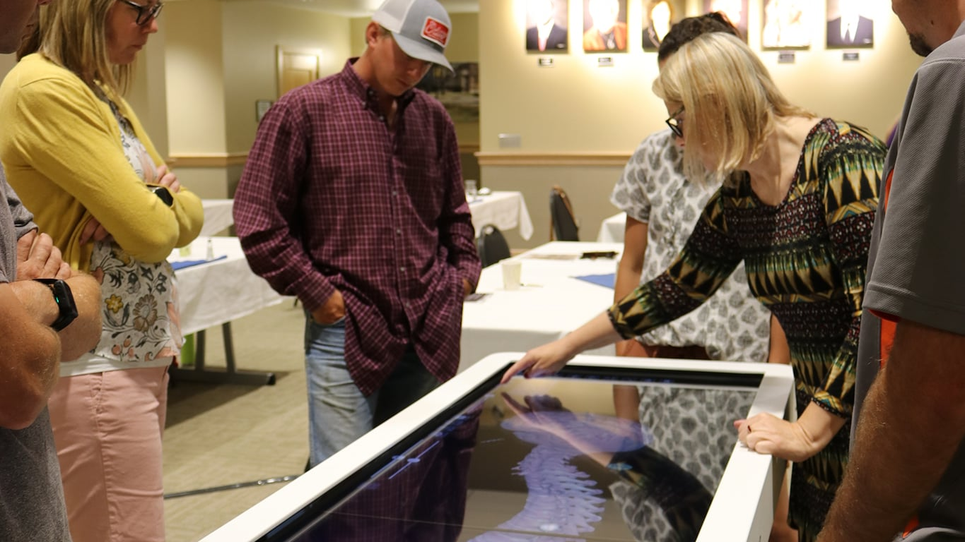
TOOLS TO BRING
IT ALL TOGETHER

Slide 27

DEPARTMENTS
DEPARTMENT OF COMMERCE
Business Development
Kansas Tourism
Community Development
Office of Broadband Development
International Development
Office of Innovation
KANSASWORKS
Office of Rural Prosperity

Slide 28
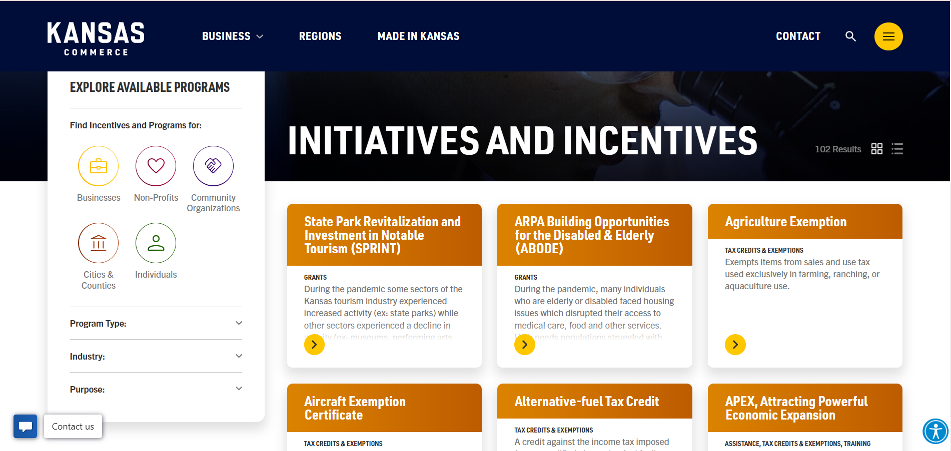
FROM COMMERCE
ONLINE LOOKUP TOOL

Slide 29
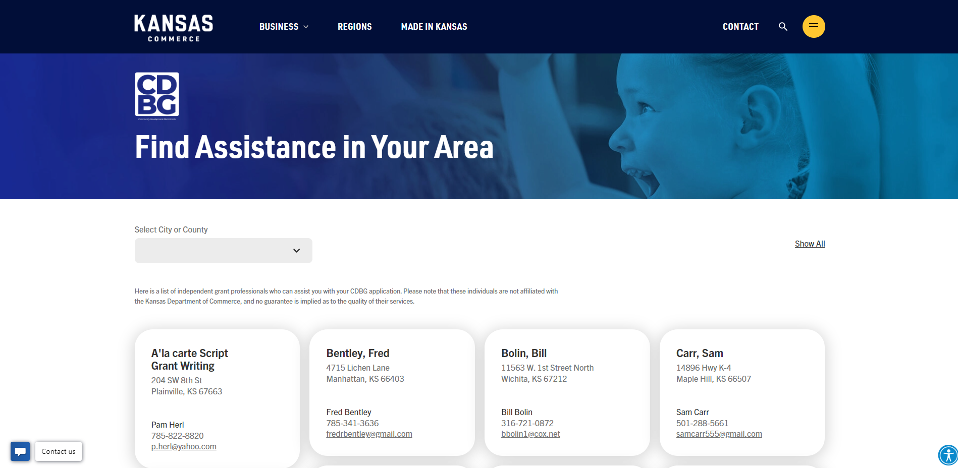
FROM COMMERCE
ONLINE RESOURCE LOOKUP

Slide 30
QUESTIONS?
THANK YOU!

